Slide 1
W Workshop on Service Learning March 9, 2015 ES PSA meeting

Slide 2
What is Service Learning?
Workshop’s Goals:
Understand the difference between Service Learning and Community Service
Discuss what „global citizenship” means
Analyze the 5 steps of Service Learning
Take a look at the Elementary Service Programs
Useful links and resources for further investigation

Slide 3
What is Service Learning?
Volunteerism - Community Service - Service Learning
Volunteerism
Help family members, neighbors, friends or organizations.
Can happen once or last for longer periods of time
Community Service = a special form of volunteerism
is a voluntary act that benefits others, usually the immediate community (= school)
usually it is not tied to a course
does not include structured reflection
the focus is on community benefits, not student learning
Service Learning
goes beyond spontaneous acts of volunteerism or fund raising activities
Integrates both curriculum content and service experience

Slide 4
What is Service Learning?
Volunteerism - Community Service - Service Learning

Slide 5
What is Service Learning?
Service Learning is a teaching and learning strategy that integrates meaningful community service with instruction and reflection to enrich the learning experience, teach civic responsibility and strengthen communities. (US National Commission on Service Learning)
AISB definition: Service Learning is a teaching and learning strategy that integrates community service with instruction in order to enhance students’ learning experience, to create a strong community and to teach civic responsibility.

Slide 6
What is Service Learning?
All our Service Learning programs are aligned with AISB’s Mission, Vision, Values, the ethos of our school:
Mission:
The American International School of Budapest prepares its students to be responsible global citizens and inspires in each a passion for knowledge and lifelong learning. We are a nurturing and diverse community that instills respect for self and others, develops the whole child, and strives for academic excellence.
Workshop question # 1: What is a „global citizen”?
In your group, come up with a definition, discuss and check AISB’s definition for global citizen.

Slide 7
What is Service Learning?

Slide 8
What is Service Learning?
The Main Characteristics of Service Learning
explores and addresses a real need / a real issue
is challenging; it requires planning and action
requires little or no money
promotes the development of student skills
engages student learning / student involvement
sets achievable goals
is reciprocal: both the provider/recipient benefit from it
impacts all parties involved
is closely tied to the curriculum
includes constant reflection from students and teachers
Source: Abad, Carmen. Service Learning. Prezi presentation. November 2014

Slide 9
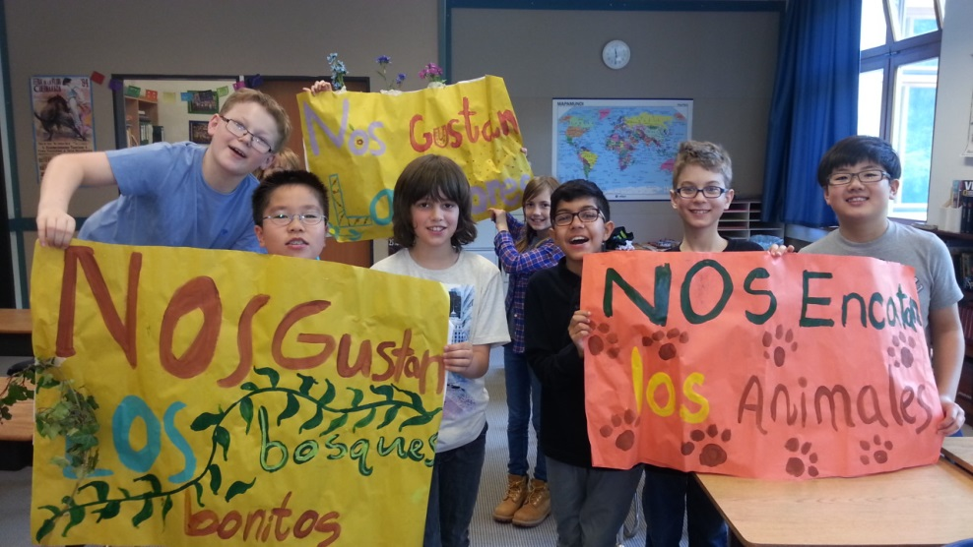
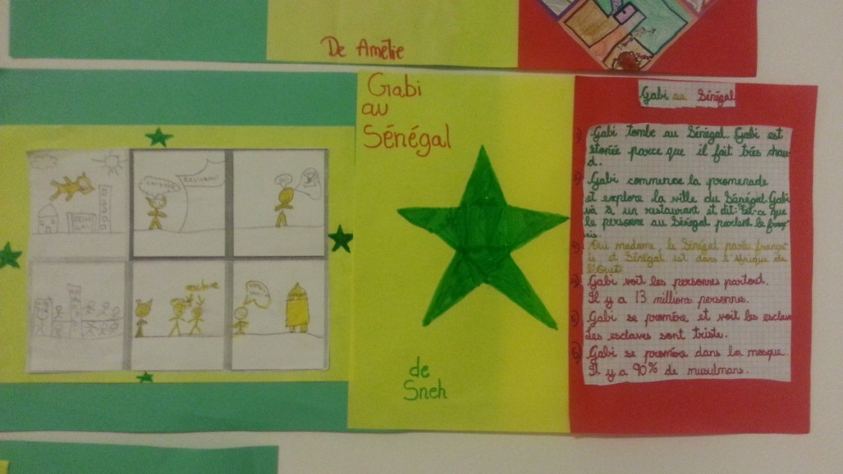
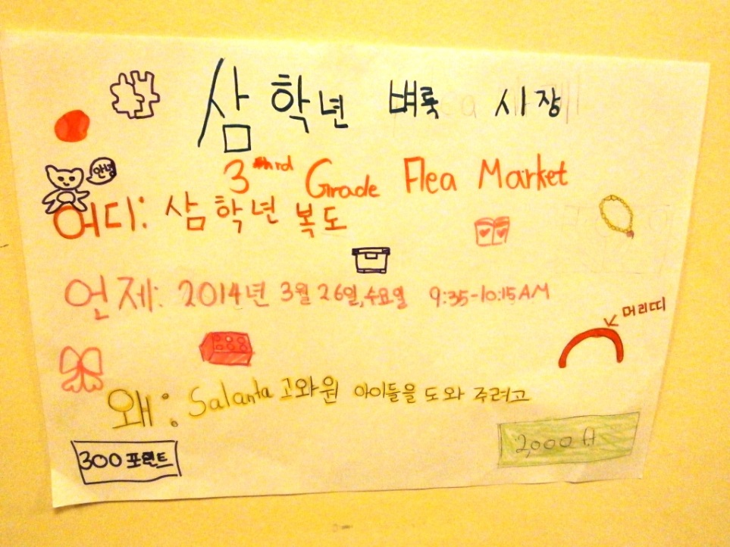
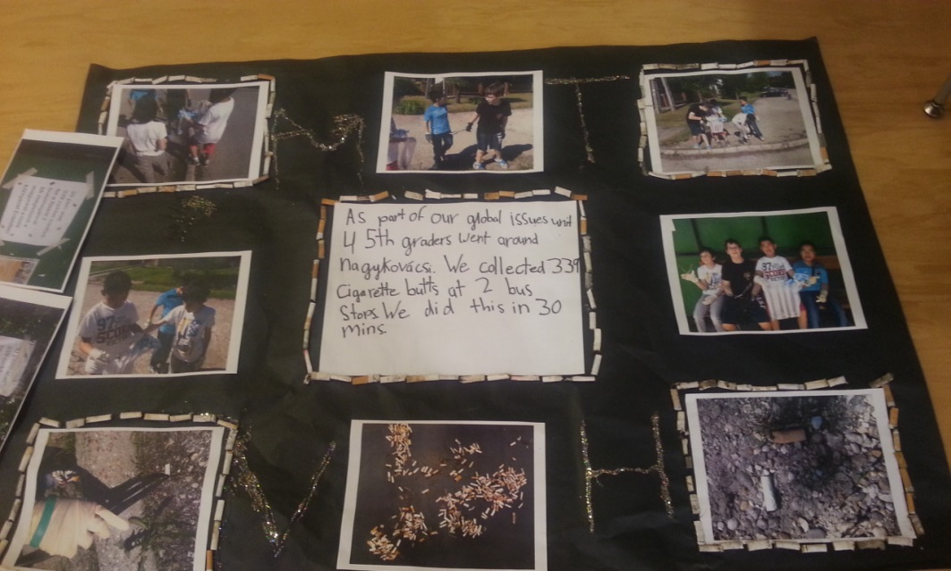
What is Service Learning?
Service Learning projects are tied to the curriculum

Slide 10
What is Service Learning?
Workshop question #2: organize the following activities under Community Service or Service Learning.
visit a local school | care for a garden | help the elderly
organize a bake sale | organize a debate on civil rights | investigate a community need
promote good behavior in the school cafeteria | create a community newsletter | visit a dog shelter
take a walk in the community | share your project at an assembly | reflect on your action plan
work in a community center | read-along activities with another class | write a letter to a friend who is ill
support another student in a distant country | organize a food drive | distribute lunch in a homeless shelter

Slide 11
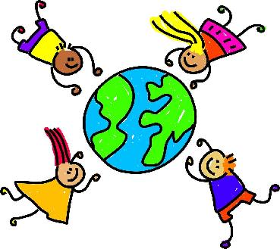
What is Service Learning?
The Five Stages of Service Learning
1) Investigation: students (with teacher’s guidance) investigate a realistic community need. Investigation involves some research and mapping the activity.
2) Planning and Preparation: Members of the community prepare a work plan (learning and service) and address the administrative issues needed for a successful project. Students plan their service activities and the project’s details.
3) Action (Implementation): This is the „heart of the project, students engage in meaningful service, learn skills, understand the unit of study and take action to achieve their learning and service goal(s).
4) Reflection: activities and question that help students to think abou their service experience, think about connection to the unit of learning, see the positive (sometimes negative) effects.
5) Demonstration/Celebration: Students share and celebrate what they have learned within their community.

Slide 12
What is Service Learning?
The 5 Stages of Service Learning
Source: Berger Kaye, Kathryn. The Complete Guide to Service Learning. Free Spirit Publishing, 2010.

Slide 13
What is Service Learning?
Grade 4 Service Program: Saving the Rainforests
Workshop question # 3: Group the following parts of the Grade 4 Service Program under any of the 5 Stages of Service Learning. Discuss in your group.

Slide 14
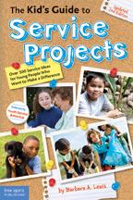
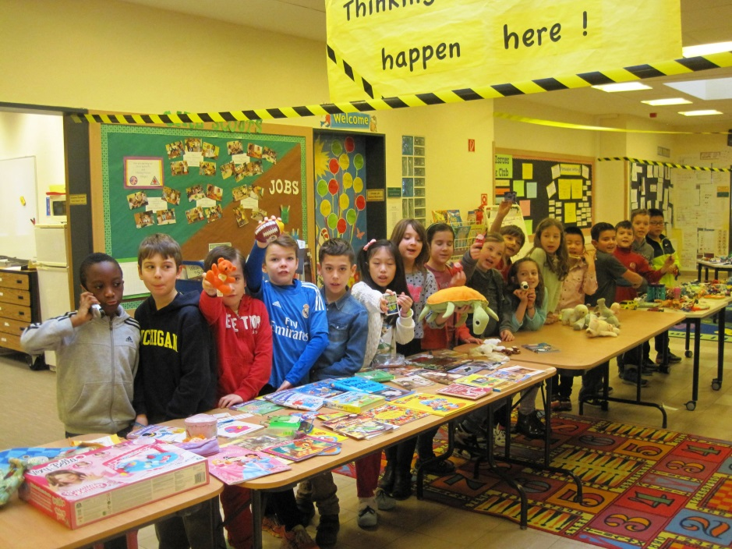
What is Service Learning?
Further Resources:
What is Service Learning? A Guide for Parents
The Five Stages of Service Learning K. Berger Kaye
Elementary Service Learning Webpage AISB
Service Learning at CEESA International Schools
AISB ES Library Search Site

